Slide 1
Shell Bootcamp 2024 3 Reflections for Week 1
<Name>
Date : 30-Aug-2024

Slide 2
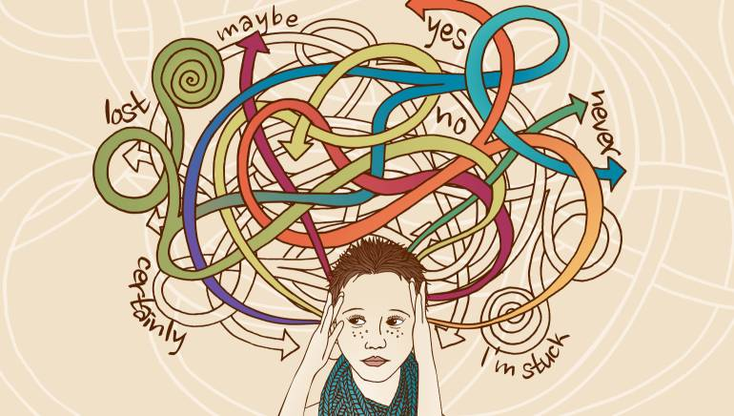
About Me
“Do the best you can until you know better. Then when you know better, do better.”
- Maya Angelou
Please share an image / visual that best represents you

Slide 3

My learnings from this week! – Technical skills

Slide 4
Learning 1 | My takeaways
Please share (in your own words) details of the learning.
Requirement analysis
Functional requirements and non-functional requirements.
Data flow diagrams and use case diagrams for requirement analysis.
[Add a graphic that provides evidence of what you learned]

Slide 5
Learning 2 | My takeaways
Please share (in your own words) details of the learning.
Scrum flow
Sprint: Scrum operates in fixed-length iterations called Sprints, typically lasting 2-4 weeks.
Daily scrum: A short, daily meeting where the team synchronizes activities, discusses progress, and plans for the next 24 hours.
[Add a graphic that provides evidence of what you learned]

Slide 6
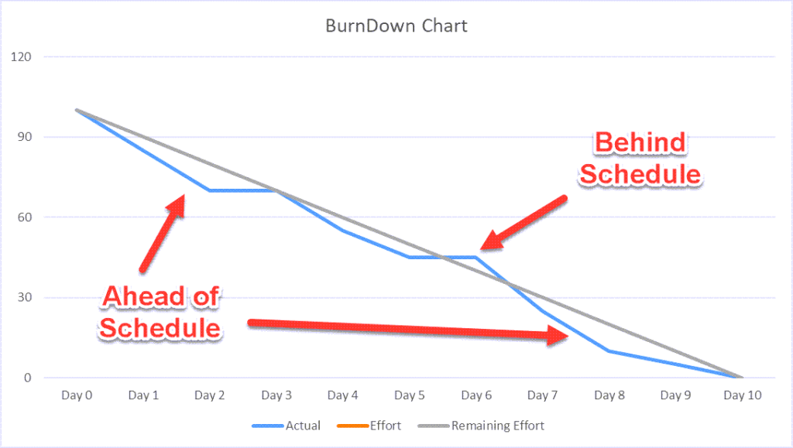
Learning 3 | My takeaways
Please share (in your own words) details of the learning.
Burn down chart
Visual Progress Tracking: A Burndown Chart is a graphical representation that shows the amount of work remaining versus the time available.
Components: The chart typically has two axes: the horizontal axis (X-axis) represents time, while the vertical axis (Y-axis) represents the amount of work remaining.

Slide 7

Relevance of learnings for my organization

Slide 8
Learning 1 | Relevance for Shell
How I feel Shell implements this learning (in your own words)
Data Collection and Analysis
Customized Recommendations
[Add a graphic that provides view of how Shell implements this learning]

Slide 9
Learning 2 | Relevance for Shell
How I feel Shell implements this learning (in your own words)
1. Sprint Planning and Execution: Shell begins each Sprint with a planning meeting where the team selects high-priority items from the product backlog. The team then breaks down these items into smaller tasks and estimates the effort
2. Daily Stand-ups and Reviews: Shell conducts daily stand-up meetings to synchronize activities, discuss progress, and address any impediments
[Add a graphic that provides view of how Shell implements this learning]

Slide 10
Learning 3 | Relevance for Shell
How I feel Shell implements this learning (in your own words)
Shell implements Burndown Charts as part of their Agile and Scrum practices to track project progress and ensure timely delivery.
They start by defining the estimation statistic, such as story points or hours, to measure the work. This helps in calculating the team's velocity and planning the workload for each Sprint.
[Add a graphic that provides view of how Shell implements this learning]

Slide 11
Thank You

